Slide 1
Early intervention project
​

Slide 2
Background and Context to the Current Early Intervention Project (E.I.P)
In 2019 Sandgate School received funding from Cumbria County Council to deliver a 12 week pilot scheme, supporting up to 28 students from across 8 Kendal Primary Partnership Schools.
The project was set up in response to evidence suggesting that the needs of students with SEND were not being consistently and effectively addressed within a range of mainstream settings. It was designed to support Cumbria County Council in their commitment to effective inclusion in mainstream settings by September 2020
Following the success of the pilot scheme further funding was allocated and Sandgate School implemented a larger EIP project, supporting both KCP (Kendal Collaborative Partnership) and SLRP (South Lakes Rural Partnership) schools.
The COVID –19 pandemic the EIP evolved to support schools both with the delivery of Remote Learning and reintegration of SEND students back to full time schooling. This involved a dynamic approach and some key changes of practice for the EIP team.
It is now proposed that the EIP should be rolled out across Cumbria by extending the already established and successful model to include delivery from other Special Schools within the county. The following document is designed to further outline and explain this established model and the vision for its extension.

Slide 3
Beneficiaries of the EIP
There are three sets of beneficiaries within the EIP
Students and their families have their needs are met, outcomes are achieved, and measurable progress is made.
Teachers and wider school community are more able to cater for the needs of all students. As staff are supported and empowered, we expect to see a swell in expertise, supporting the wellbeing of staff and students alike.
Cumbria County Council will deliver on their commitment to supporting SEND students within mainstream settings and reduce spending in the long term.

Slide 4
Aims and Outcomes of the EIP
The EIP aims to help ensure the needs of SEND students across the county are met within mainstream settings, by providing a stable, consistent and forward-thinking, time limited programme designed to offer advice, structure and support.
The EIP outcomes are to ensure:
Students have IEP targets which are reflective of their learning and behavioural needs and will therefore enable them to make progress against wider measures.
Parents feel supported within the process and can perceive the progress made by their child.
Mainstream practitioners are supported and empowered to deliver targeted provision to support SEND students
Schools, as whole, will be able to effectively support SEND students through their evolving and improved understanding, ethos and practice.
Schools are supported to support SEND students and their families within the extended COVID-19 recovery period. E.g. planning for the possible long-term effects of lockdowns such as projected language delay and rise in potential attachment disorders.
There is a clear referral process to the EIP which begins with the Early Help process.
The EIP works collaboratively and in tandem with existing support services / agencies to provide consistent advice, support and the best possible outcomes for SEND students across the County.

Slide 5
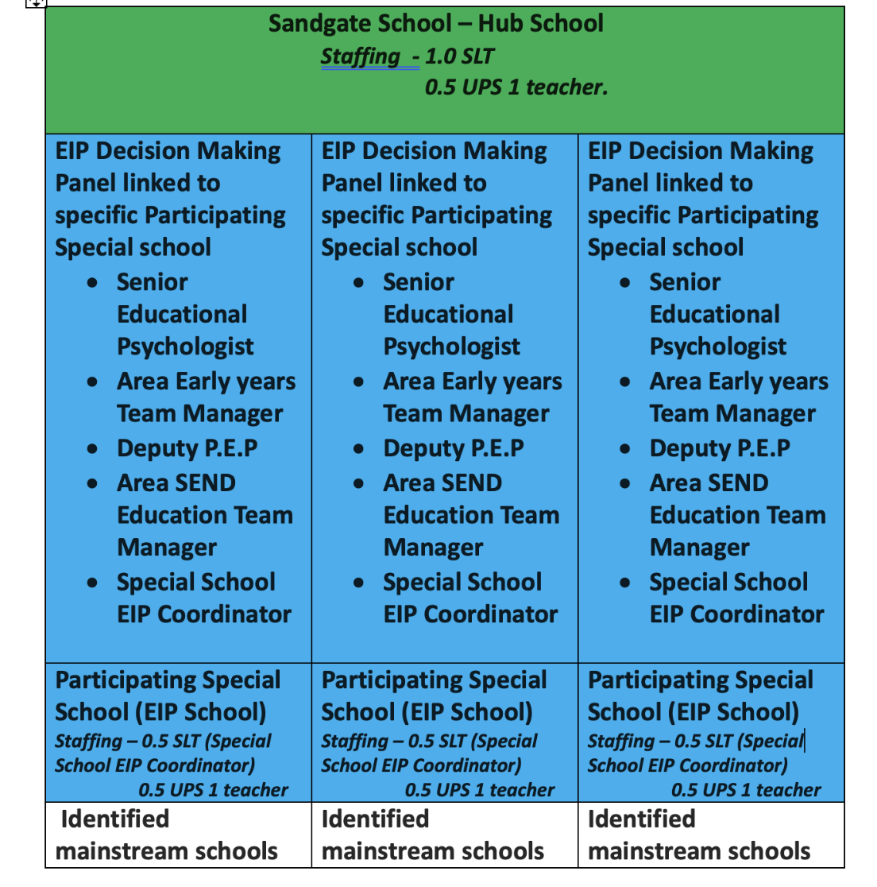

Slide 6
Sandgate School will be responsible for:
Supporting identified Special Schools (EIP schools) with initial set up and training and cascading knowledge acquired during their own initial set up period.
Interrogating data across the County; looking at clusters of need, then linking schools together to ensure effective cascading of training.
Providing ongoing advice and experience to EIP schools.
Overseeing, managing and monitoring the online platforms through which the EIP will be administered, including OneDrive and SOLAR.
Providing ongoing accountability and monitoring of the EIP, including updates and evaluations.
Gathering and assessing evidence for County purposes.
Continuing to deliver within their role as a EIP school for their identified catchment area.

Slide 7
EIP Decision Making Panels will be responsible for :
Meeting half termly.
Ensuring quoracy (Chair +2 members)
Agreeing and actioning referrals to the EIP for individual students based on the evidence submitted to them.
Reviewing the progress made by the identified students following EIP intervention and support.
Agreeing intervention extensions.
Ensuring decision making is consistent.
Reporting on consistent themes and strategic data.

Slide 8
Identified Special Schools (EIP schools) will be responsible for:
Running and attending the EIP Decision Making Panels. This will include collating the information around referrals and preparing the agenda for the panel. This will take be circulated one week before the panel date. Panels will meet half termly.
Running the referral and delivery process of the EIP to mainstream settings within their catchment area. Further details of this process will be outlined within this document.
Signing and adhering to staff guidelines laid out in Appendix 8
Liaising with Sandgate School as a hub school to ensure continuity of provision, accountability and to share practice and resources. This include uploading and updating records within the shared online platform and attendance at regular EIP stakeholder meetings.

Slide 9
Mainstream schools will be responsible for:
Opening an Early help for identified students.
Referring identified students to the relevant EIP schools.
Signing and adhering to the host school agreement. (See Appendix 1 )
Providing supporting schools with as much information as possible about the students they are referring.
Working with their supporting school to follow advice, attend meetings and upload information, IEP updates and assessments as the process requires.
Complete any evaluation/ feedback forms that may be required.

Slide 10
Who can be referred to the EIP?
The EIP is designed to support Primary Students across Cumbria who experience SEND or comparable barriers to learning.
A mainstream team who requires additional support or strategies to enable a student to make progress can refer to the relevant Special School.

Slide 11
How will mainstream schools know which EIP school to refer to?
It is envisaged that once Special Schools have been established as ‘ EIP Schools’ a county wide provision map will be drawn up which will identify catchment areas for each EIP school.
Mainstream schools will then be informed of their local EIP school and the support that they can offer. Following the Sandgate Model, we envisage the EIP will be introduced to schools through targeted presentations delivered at local schools forums, similar to KCP and SLRP meetings.

Slide 12
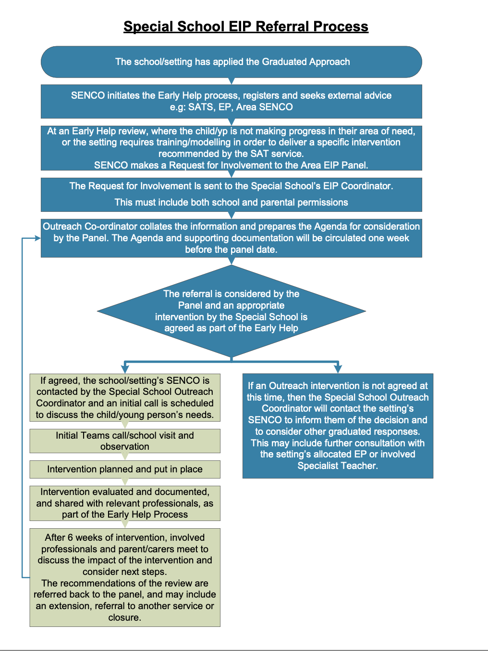
Notes:
Before a SENCO can make a referral to the Area EIP panel an Early Help must be opened.
Referrals are made online. This is through Microsoft Teams and can be found on the OneDrive. Each EIP school will have their own designated referral forms.
The referral process requires the completion of two referral forms:
- School Referral Form (See Appendix 2a)
- Pupil Referral Form (See Appendix 2b)
Both forms need to be completed before the referral can be considered at EIP Decision Making Panel.
Before a SENCO can make a referral to the Area EIP panel an Early Help must be opened.
Referrals are made online. This is through Microsoft Teams and can be found on the OneDrive. Each EIP school will have their own designated referral forms.
The referral process requires the completion of two referral forms:
- School Referral Form (See Appendix 2a)
- Pupil Referral Form (See Appendix 2b)
Both forms need to be completed before the referral can be considered at EIP Decision Making Panel.

Slide 13
FIRST steps
Once a student is accepted on to the EIP, EIP staff will immediately begin a Record of Support form. (see Appendix 4) This should be uploaded to the student's online file. This form is designed to monitor the level of support provided by the EIP to schools and individual students.
EIP staff will contact the lead member of staff on the contact form and via an initial online meeting they will gather further information based on the referral.
Prior to this meeting the school will be sent an online copy of the host school agreement (Appendix 1). This should be signed and returned by the date of the initial online meeting. This should be uploaded to the pupils file on the EIP online platform.
The discussion at this meeting will be framed around the information provided on referral forms but also the report proforma, found in Appendix 5. EIP staff will take notes at this meeting and add them to the Record of Support forms (Appendix 4) these will be uploaded to the online platform, along with initial referral forms. (See appendix )
At this meeting both parties will agree a mutually convenient time to come into school and observe the referred student.
Notes:
Share Appendix 4

Slide 14
School Visit – Observation and Information Gathering.
On the day of the visit EIP staff will arrive at the host school at the arranged time.
They will observe the child ideally working in a number of different scenarios and in a variety of tasks, in order to obtain an overview of the students' needs and strengths.
The EIP staff may also want to spend some time with the staff who know the referred student best and share initial ideas and thoughts.
On the day of the visit schools should have a copy of the following documents available to share with EIP staff, if they are relevant to the referred student.
-EHCP
-Current Individual Education Plan
-Relevant medical information
-Latest school report
-PEP information
-Details of TAF/ TAC/ Early Help meetings
-Reports from other relevant services or professionals
These documents should be uploaded to the student’s file in the Online Platform.
Staff may also be able to offer solutions to some problems within the visit and direct staff to a range of resources to initiate immediate change.

Slide 15
Safeguarding and gdpr
All EIP practitioners should be operating within both their own school’s Safeguarding Policy and that of the Host School. All practices would be in line with KCSIE framework.
The EIP’s specific GDPR notice can be found in Appendix 9.

Slide 16
Reporting writing and resourcing
Once the visits has concluded EIP staff will begin compiling a report regarding the referred student. This report will be emailed to the school within 10 working days of the school visit.
This report will be informed by:
- Initial Online meeting
- School visit / Observation and discussions
- Supporting evidence provided by the host school
The report will allocate the most appropriate member of EIP staff to support the school going forward.
EIP staff will draft a new IEP for the duration of the programme based on established need. This IEP will be uploaded to SOLAR. A SOLAR log in will be set up for host school staff and the login procedure will be explained within the email accompanying the student report.
Host school staff will also be signposted to other aspects of SOLAR which may be relevant including Behaviour Incidents reports and Assessment Trackers.
Notes:
Share report format

Slide 17
First stage review
The EIP staff and the host school will arrange a date for an interim review 3 weeks after the report has been received. This should include progress towards agreed IEP targets as set on SOLAR which. These can be conducted either online or in person, depending on the individual circumstances. Details of the review should be recorded on the record of support form and on the SOLAR IEP.
In the time between receiving the report and the first review the EIP staff will respond to email or phone contact from the host school.
Any support given during this time should be logged on the student’s Record of Support form (Appendix 4)
Notes:
Share SOLAR platform

Slide 18
SECOND review
There should be a further and potentially final review of the IEP and general progress 6 weeks after the report is received. Details of the review should be recorded on the record of support form and on the SOLAR IEP.
At this review a decision should be made to close support or refer back to EIP decision making panel.
When support comes to an end schools will be asked to complete an evaluation form.

Slide 19
Further possible eip school actions
In addition to the agreed and standard interventions listed above EIP staff may also offer the following support:
Supplying resources (physically or electronically). Records of these should be uploaded to student file.
Signpost to Symwriter or a similar package to make visual supports
Write or adapt Positive Behaviour Support plans (See appendix 6) . This should be uploaded to student file
Undertake behaviour analysis based on behaviour incidents recorded on SOLAR. (See appendix 7). This should be uploaded to student file
Signpost to external agencies / further support
Welcome staff from host school in to EIP school to observe relevant practice and implementation of identified strategies
Offer CPD sessions where appropriate
Attend EHCP review / Early Help meetings etc if appropriate.
All support offered should be recorded on Record of Support Given Document in the student’s online file.

Slide 20
Actions of Host School Staff following a visit
Host school staff will:
Commit to implementing actions/ teaching methods/ strategies suggested for agreed/ required period of time.
Upload progress onto the IEP via SOLAR at, or before each review meeting.
If identified as appropriate, enter any behaviour incidents onto SOLAR as they occur.
Following Positive Behaviour Support Plans written in conjuction with EIP staff.
Be able to contact the EIP team via email.

Slide 21
IEP Reviews
At the time of delivering the initial report EIP staff should book in at two IEP review meetings. These should be at the 3 week and 6 week point.
These meetings are crucial to the process as:
They monitor the progress made by students
They allow all staff to evaluate the effectiveness of the interventions made and make changes as necessary
Provide data on the effectiveness of the EIP as a whole and feed into review cycles.
When a review takes place EIP and host staff should maintain, adjust or rewrite the review as appropriate.

Slide 22
When does the programme end?
Support offered to each student will be individualised based on need and circumstance. However, the earliest point at which the programme should end is after two IEP review cycles.
At this point host and EIP school staff should decide on one of two options:
Support is no longer required and the programme is closed for this student.
Referral back to panel to extend support.

Slide 23
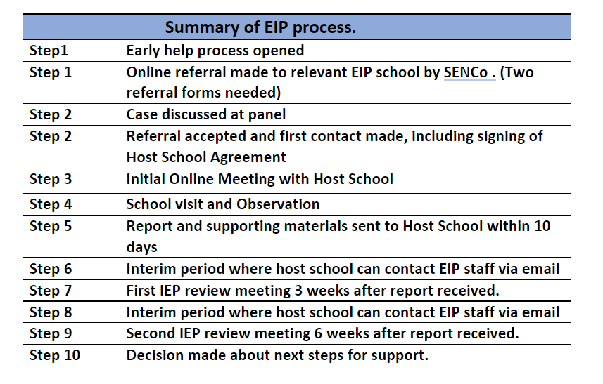
Summary of process

